Slide 1
Multiple testing on experimental economics data
Dongyin Hu
Notes:
Hello everyone, I am Dongyin Hu and my project title is An FWER control procedure on experimental economics data. I am from the ECE department and have only a shallow understanding about the economics problem being discussed here. Please correct me if you notice anything that is confusing.

Slide 2
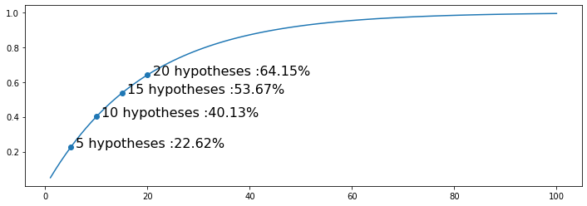
Background I
Is having more data always the better?
Suppose each test is conducted at level α and the p-values are independent, then the family-wise error rate (FWER), the probability of one or more false rejections is estimated:
FWER = 1 − ( 1 − α )^{N}
The combination of treatments, subgroups, and outcomes leads to a soaring number of hypotheses.
Notes:
In this project, I would like to investigate a problem related with fundraising and charity. An organization may solicite money from subscribers for some reasons, for example, animal protection, improving education in a certain community, or some political events. A key concern for the fundraisers is, how to raise more money? A simple yet difficult question.
In practice, many fundraisers are using a method called matching grants. There is a leadership donor, who promises to offer an extra amount of money to your gift until a predetermined threshold is reached. So for example, when you donate $1, the donor will donate $2, if the matching ratio is 2:1. And the total extra amount is set to a certain limit which can be $25,000 for example. The donor will not add more money if $25,000 has been given out.
There is a rul of thumbs for fundraisers: the higher the matching ratio, the more money will be received. The problem is, is this correct

Slide 3






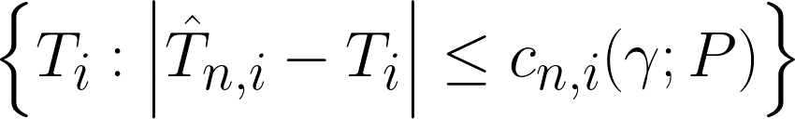
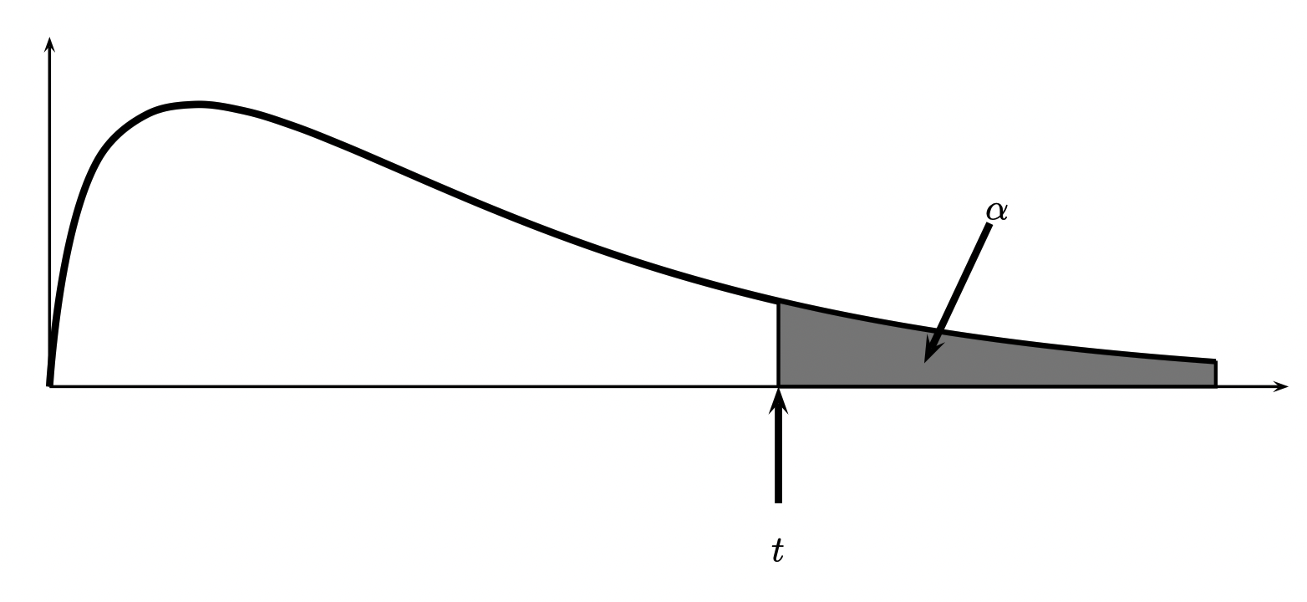
Theoretical Calculation I: Notations
are samples collected from a unknown distribution P. n is the sample size.
index set of real null hypotheses.
as the null hypotheses, where i is drawn from the index set S.
as the test statistic estimated from the samples.
as the real test statistic.
as the distribution of absolute difference.
as the confidence interval, where c is the largest gamma quantile.
Notes:
In this project, I would like to investigate a problem related with fundraising and charity. An organization may solicite money from subscribers for some reasons, for example, animal protection, improving education in a certain community, or some political events. A key concern for the fundraisers is, how to raise more money? A simple yet difficult question.
In practice, many fundraisers are using a method called matching grants. There is a leadership donor, who promises to offer an extra amount of money to your gift until a predetermined threshold is reached. So for example, when you donate $1, the donor will donate $2, if the matching ratio is 2:1. And the total extra amount is set to a certain limit which can be $25,000 for example. The donor will not add more money if $25,000 has been given out.
There is a rul of thumbs for fundraisers: the higher the matching ratio, the more money will be received. The problem is, is this correct

Slide 4
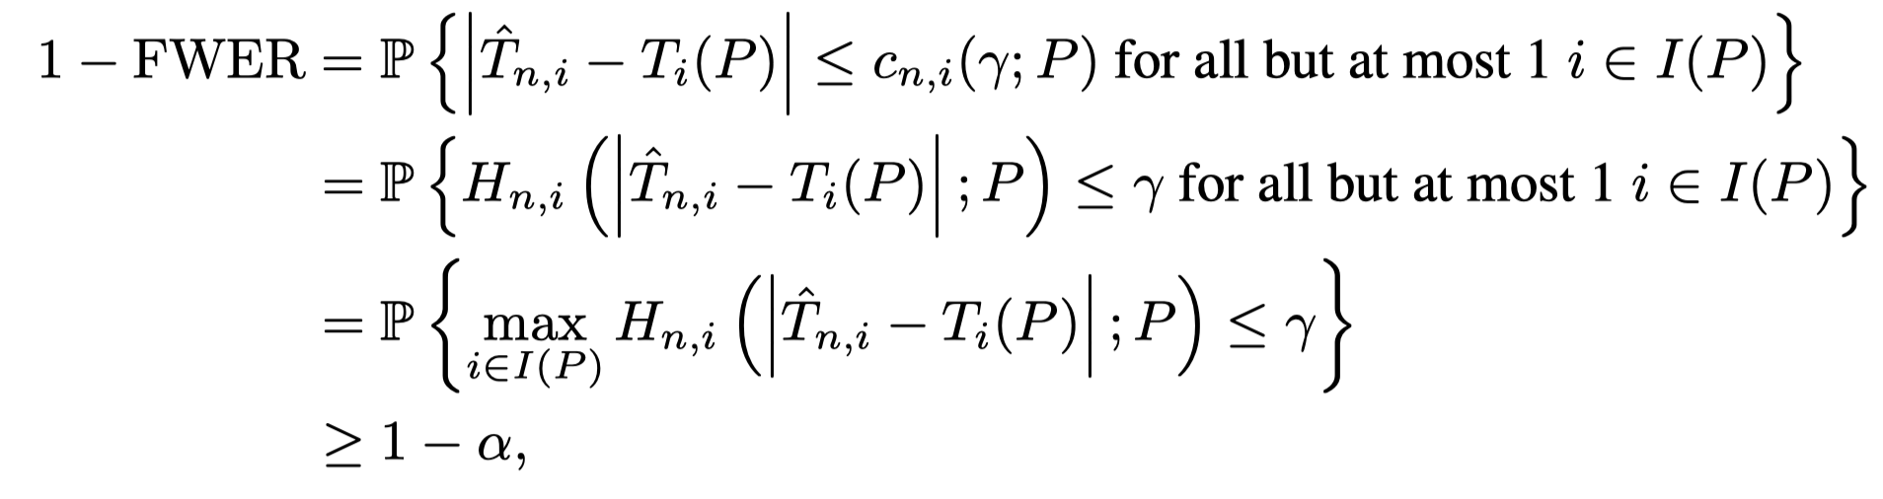
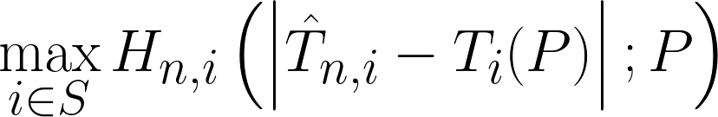
Theoretical Calculation II: FWER control
If we known the distribution of
we can solve the previous equation.
This requires:
Estimation of the CDF Hn,i.
Estimation of the CDF of max Hn,i
Notes:
In this project, I would like to investigate a problem related with fundraising and charity. An organization may solicite money from subscribers for some reasons, for example, animal protection, improving education in a certain community, or some political events. A key concern for the fundraisers is, how to raise more money? A simple yet difficult question.
In practice, many fundraisers are using a method called matching grants. There is a leadership donor, who promises to offer an extra amount of money to your gift until a predetermined threshold is reached. So for example, when you donate $1, the donor will donate $2, if the matching ratio is 2:1. And the total extra amount is set to a certain limit which can be $25,000 for example. The donor will not add more money if $25,000 has been given out.
There is a rul of thumbs for fundraisers: the higher the matching ratio, the more money will be received. The problem is, is this correct

Slide 5
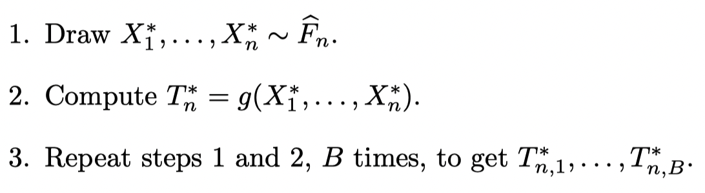

Theoretical Calculation III: Bootstrap
The Bootstrap method is to repetitively draw samples from the existing samples to estimate the property of a test statistics, such as variance or ecdf.
In order to get
, we sample data B times, and calculate
. Then we can estimate the distribution. Further, we repeat the bootstrap for all hypoth-
ses, so as to estimate the distribution of
Notes:
In this project, I would like to investigate a problem related with fundraising and charity. An organization may solicite money from subscribers for some reasons, for example, animal protection, improving education in a certain community, or some political events. A key concern for the fundraisers is, how to raise more money? A simple yet difficult question.
In practice, many fundraisers are using a method called matching grants. There is a leadership donor, who promises to offer an extra amount of money to your gift until a predetermined threshold is reached. So for example, when you donate $1, the donor will donate $2, if the matching ratio is 2:1. And the total extra amount is set to a certain limit which can be $25,000 for example. The donor will not add more money if $25,000 has been given out.
There is a rul of thumbs for fundraisers: the higher the matching ratio, the more money will be received. The problem is, is this correct

Slide 6

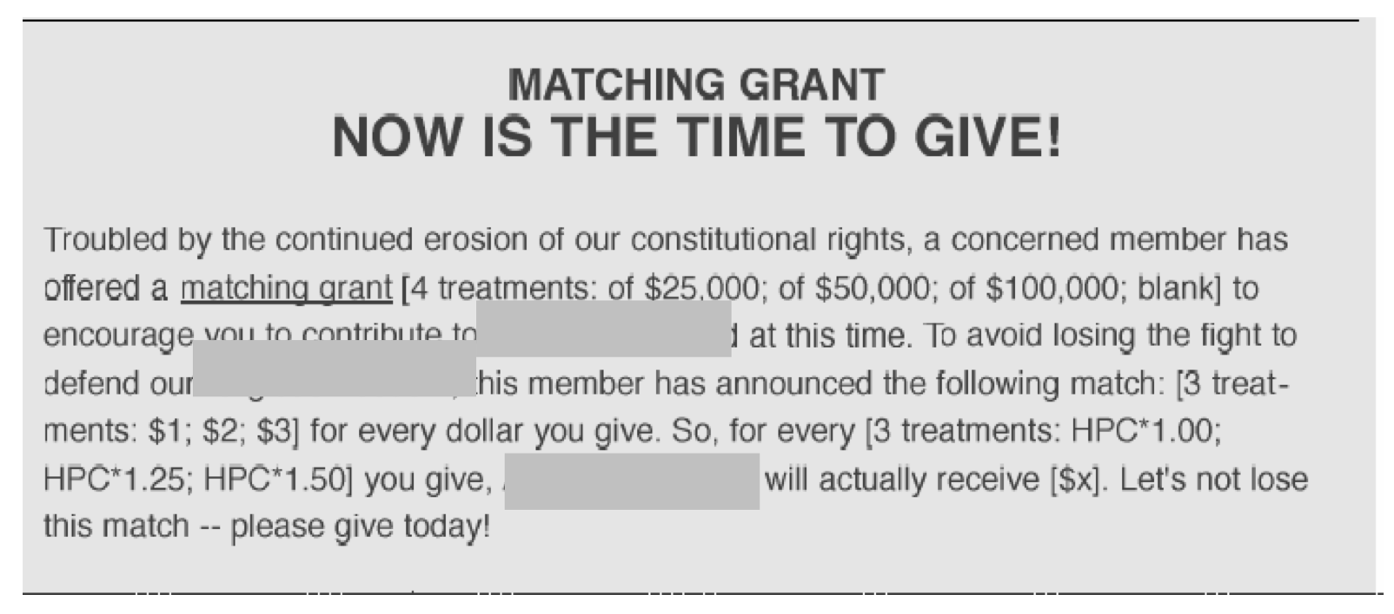


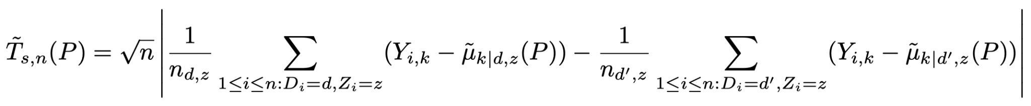
Background II
Matching grants/gifts:
A leadership doner will promise to offer an extra amount to your grant until a predetermined threshold amount is reached.
Notes:
In this project, I would like to investigate a problem related with fundraising and charity. An organization may solicite money from subscribers for some reasons, for example, animal protection, improving education in a certain community, or some political events. A key concern for the fundraisers is, how to raise more money? A simple yet difficult question.
In practice, many fundraisers are using a method called matching grants. There is a leadership donor, who promises to offer an extra amount of money to your gift until a predetermined threshold is reached. So for example, when you donate $1, the donor will donate $2, if the matching ratio is 2:1. And the total extra amount is set to a certain limit which can be $25,000 for example. The donor will not add more money if $25,000 has been given out.
There is a rul of thumbs for fundraisers: the higher the matching ratio, the more money will be received. The problem is, is this correct

Slide 7
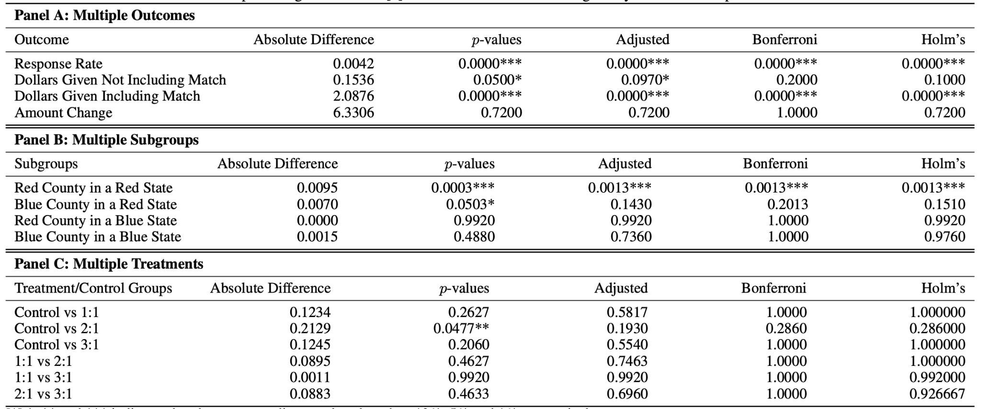
Full Data Analysis I: Reproducing the results
Notes:
So, in a 2007 work, several researchers conducted an experiement to see the effect of matching grants. They sent out letters to solicite contributions from previous donors. In addition to the matching ratios we discussed before, more factors are considered as well: the maximum amout of of the matching gift and the suggested donation amount are changed for different donors. For the matching ratios, they tested 3 ratios. For the maximum amount, they set 4 values, and for the suggested smount, 3 levels are set as well. This results a total of 36 treaments, which is color coded in blue as shown in the sample data.
Also, since the reason for raising money is political, the researchers also divided the donors into 4 subgroups, which are red/blue state and red/blue counties. This is color coded in yellow. Note some other onformation is collected as well, such as marital status, gender or legal status.
Finally, there are four outcomes of interest - the reponse rate, defined as the number of donation received over the total number of letters sent out, dollars given without the matching amount, dollars given with the matching amount, and the changed inthe amount given.

Slide 8
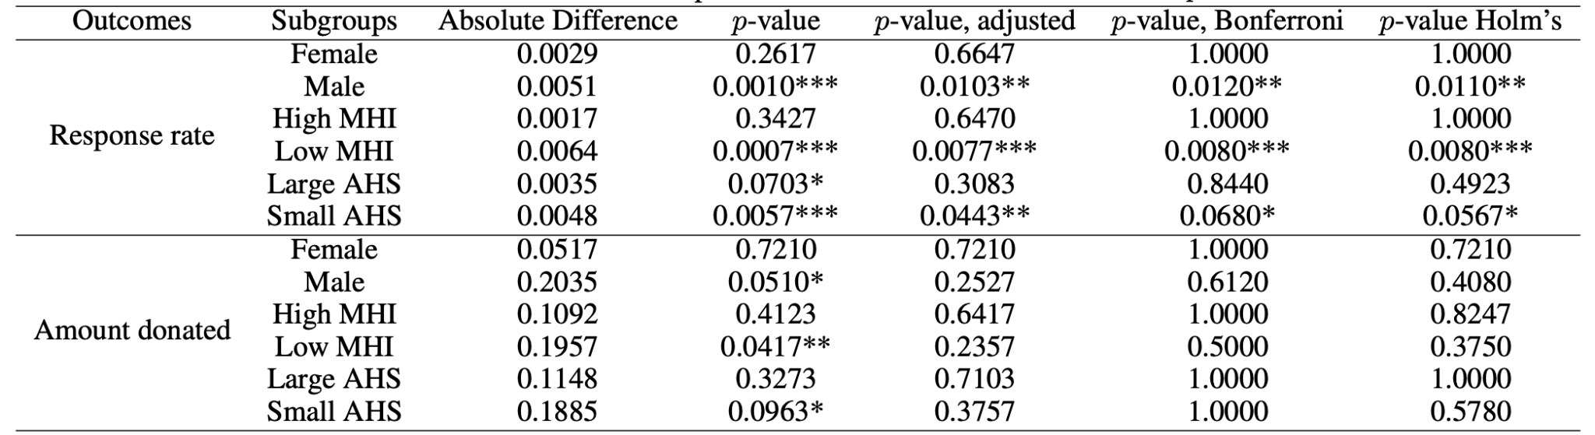
Full Data Analysis II: New insights (testing)
Statistic testing
Matching grants are more effective on male, families with relatively lower median household income and relatively small household size on response rate. While the amount donated is not significant after adjustment.
Notes:
Now let's look at some statistics about the results. A total number of 50k subjects are asked, and 1/3 of them are assigned to the control group. The 36 treatments are assigned with equal possibility to all in the treatment groups.
And for the outcomes we concern, they are shown in the 4 bar charts w.r.t. the matching ratios, From the left to the right are reponse rates, amount w/o matching per letter, amount with matching per letter, and amount change. And the x-axis is a 1:1 ratio, 2:2 ratio, 3:1 ratio and the control group. We can see that the reponse rate of the three treatment groups seems to be higher, and the amount w/o matching per letter is higher as well. Note this amount is normalized by the size of each group. And for the amount with matching, of course that is higher than the control group. For the amount change, not a clear trend is observed.

Slide 9
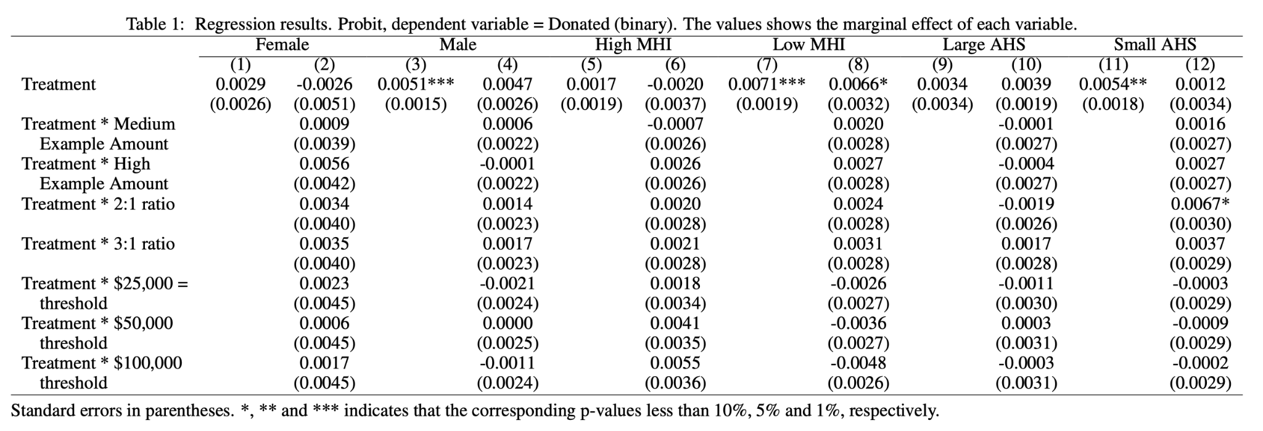


Full Data Analysis III: New insights (GLM)
Ti is a indicator of treatment or not.
Si, Ri, Ai are vectors of indicators of Matching Sizes, Matching Ratios, and Example Amount.
Notes:
In this project, I would like to investigate a problem related with fundraising and charity. An organization may solicite money from subscribers for some reasons, for example, animal protection, improving education in a certain community, or some political events. A key concern for the fundraisers is, how to raise more money? A simple yet difficult question.
In practice, many fundraisers are using a method called matching grants. There is a leadership donor, who promises to offer an extra amount of money to your gift until a predetermined threshold is reached. So for example, when you donate $1, the donor will donate $2, if the matching ratio is 2:1. And the total extra amount is set to a certain limit which can be $25,000 for example. The donor will not add more money if $25,000 has been given out.
There is a rul of thumbs for fundraisers: the higher the matching ratio, the more money will be received. The problem is, is this correct

Slide 10
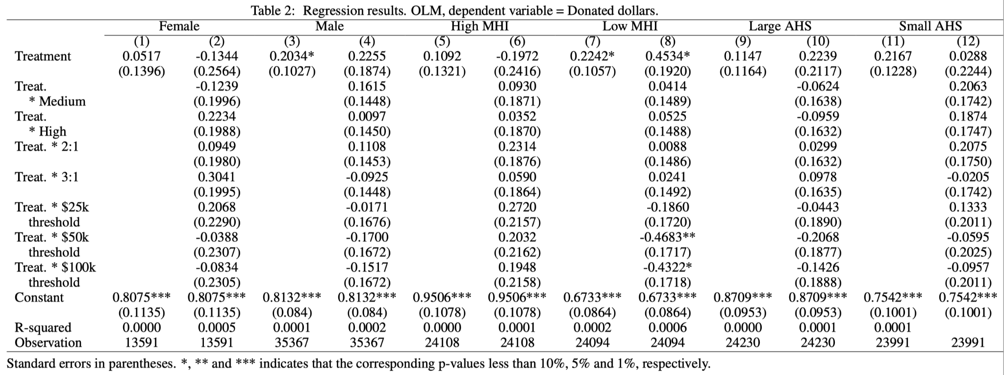

Full Data Analysis IV: New insights (OLS)
Ti is a indicator of treatment or not.
Si, Ri, Ai are vectors of indicators of Matching Sizes, Matching Ratios, and Example Amount.
Notes:
Now let's look at some statistics about the results. A total number of 50k subjects are asked, and 1/3 of them are assigned to the control group. The 36 treatments are assigned with equal possibility to all in the treatment groups.
And for the outcomes we concern, they are shown in the 4 bar charts w.r.t. the matching ratios, From the left to the right are reponse rates, amount w/o matching per letter, amount with matching per letter, and amount change. And the x-axis is a 1:1 ratio, 2:2 ratio, 3:1 ratio and the control group. We can see that the reponse rate of the three treatment groups seems to be higher, and the amount w/o matching per letter is higher as well. Note this amount is normalized by the size of each group. And for the amount with matching, of course that is higher than the control group. For the amount change, not a clear trend is observed.

Slide 11
Conclusion
A Python implementation of the proposed algorithm. [available at https://github.com/Voivio/DSC-291-Project]
Using linear regression and Probit model and multiple testing methods to analyze the data.
  Matching gifts do increase the response rate and amount donated.
  Higher matching ratios do not seem to be effective.
  For this specific fund raising event, matching gift increases the response rate more in red states.
New insights from the existing data.
  Male, families with relatively low median household income and relatively small household size are influenced by matching gifts on response rate. [Amount donated is accepted after adjustments]
  The Probit model shows the similar results as in a). Further, a 2:1 ratio has statistically significant influence for families with relatively small household size on response rate.
  The OLS linear regression model shows that the amount of dollar donated by male and families with relatively low median household income are significantly influenced by matching gifts. Further, a large threshold negatively influences the dollar donated.
Learned more about the principles behind the multiple testing p-value adjustment.

